Slide 1


AtliQ Hardwares
Consumer Goods
Ad-hoc Insights
Created By
Jeeva Anand

Slide 2
AGENDA
Background
Getting Familiar with AtliQ Hardware’s Business
Getting familiar with data given
Ad-hoc requests along with the queried results and visualizations.

Slide 3
Our Company AtliQ Hardwares (Imaginary Company) – One of the leading computer hardware producers in India. Background The Management noticed that they do not get enough insights to make smart data informed decisions. Problem There are 10 Ad-hoc requests for which the company needs insights. Approach Run a SQL query to answer these requests. Convert it into visualizations and present insights to top level management.
BACKGROUND

Slide 4
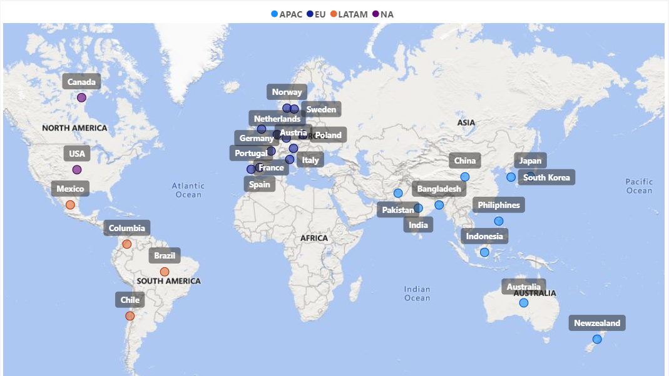
Page 1
AtliQ Hardware Markets
Notes:
map
No alt text provided

Slide 5
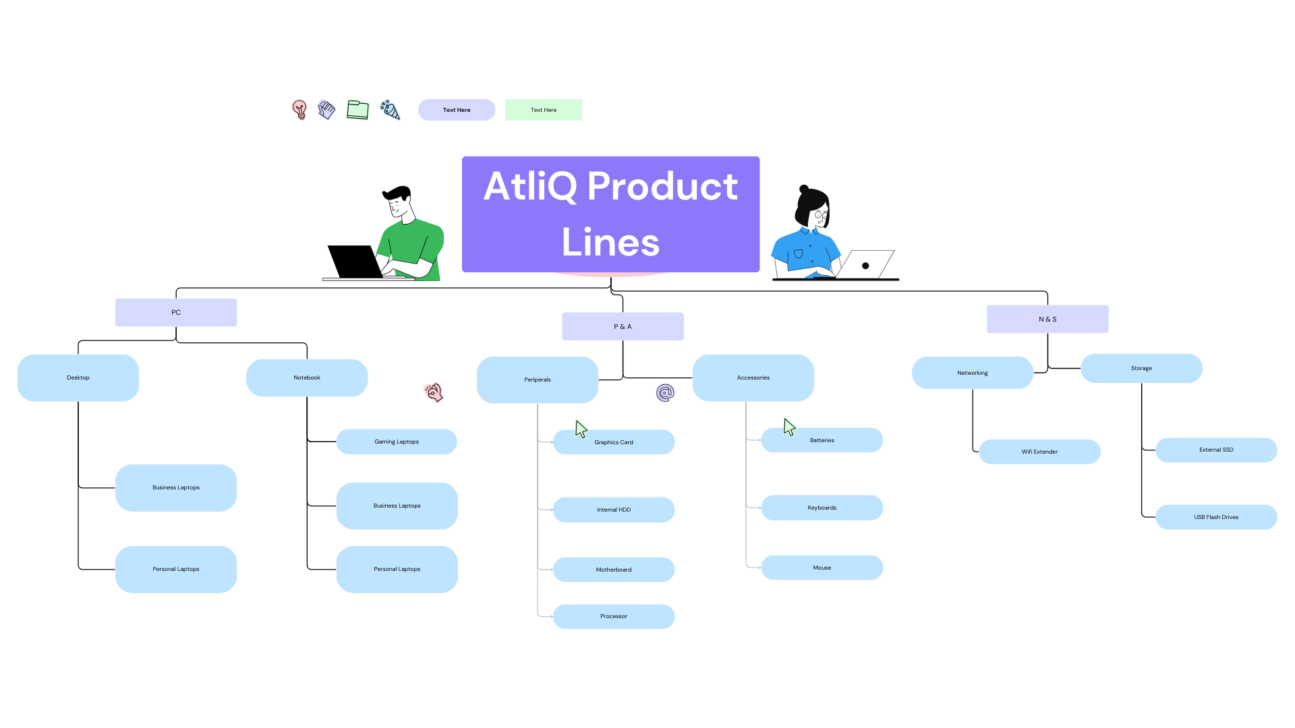

Slide 6
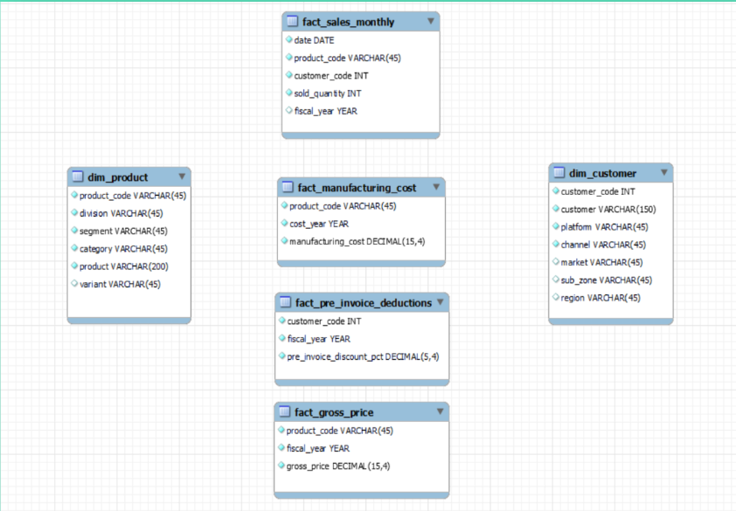
Getting Familiar with the Input Data

Slide 7
Ad-hoc Requests

Slide 8
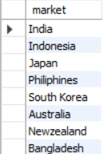
Request 1
Provide the list of markets in which customer “AtliQ Exclusive” operates it’s business in the APAC region

Slide 9
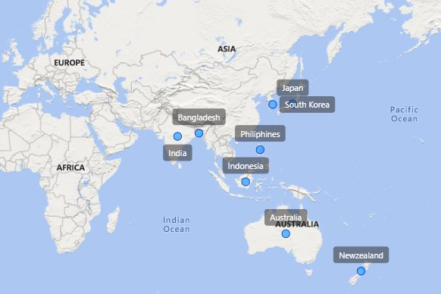

Slide 10

Request 2
What is the Percentage of unique product increase in 2021 vs 2020?

Slide 11
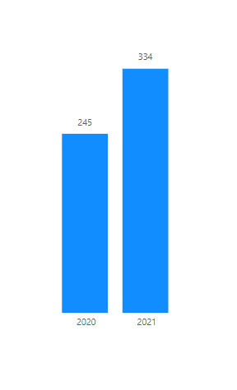
It’s a good sign that we are continuously innovating and
Introducing new products to the market. In FY 2020, we
Had a total of 245 products, but in FY 2021, Our number
Increased by 36% to 334 products.

Slide 12
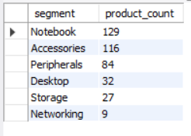
Request 3
Provide a Report with all the
Unique product counts for each
segment and sort them in
descending order of product
Counts.

Slide 13
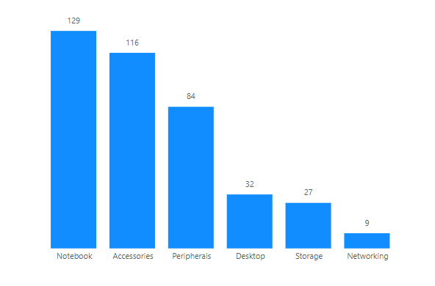
We provide a wide range of products under the segments, Notebooks, Peripherals and accessories,
With

Slide 14
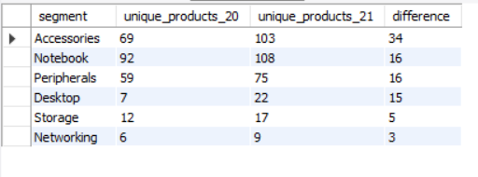
Request 4
Follow-up : Which Segment had the most increase
in unique products in 2021 vs 2020?

Slide 15
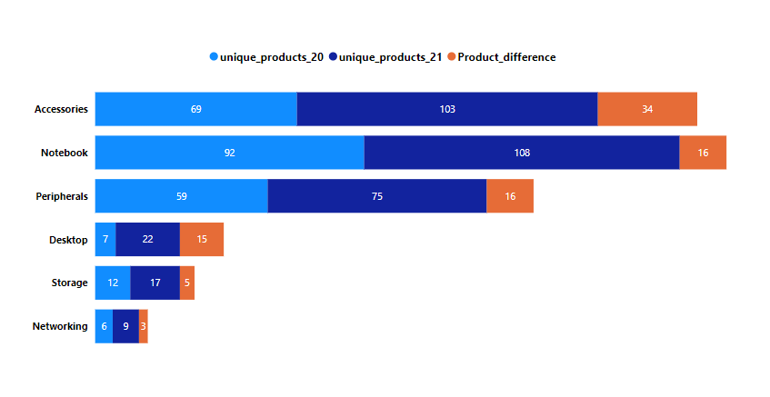
With the Introduction of 34 new products, Accessories segment has the highest increase in number of unique products.
Notebooks and Peripherals each have an increment of 16 new unique products.
The Team has done a good job in Desktop Segment by increasing from 7 to 22.
Networking segment is at the bottom with 3 new products.

Slide 16
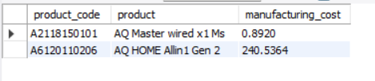
Request 5
Get the products that have the highest and lowest manufacturing costs.

Slide 17


Which of our product has
Highest manufacturing cost?
Which of our product has
Lowest manufacturing cost?
240.54
0.89
AQ Home Allin 1 Gen 2 (plus 3)
Personal Desktop
AQ Master Wired x1 Ms (Standard 1)
Mouse

Slide 18
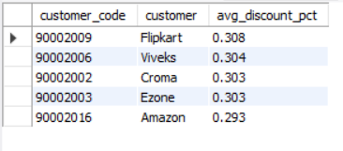
Request 6
Generate a report which contains the top 5 customers who received an average high pre invoice discount pct
For the fiscal year 2021 and in the Indian Market

Slide 19
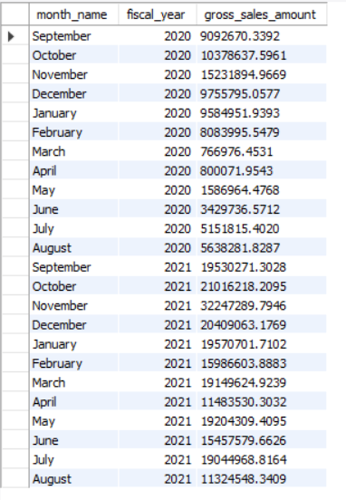
Request 7
Get the complete report of the Gross sales amount for the customer “Atliq Exclusive” for each month. This analysis helps to get an idea of low and high-performing months and take strategic decisions.

Slide 20
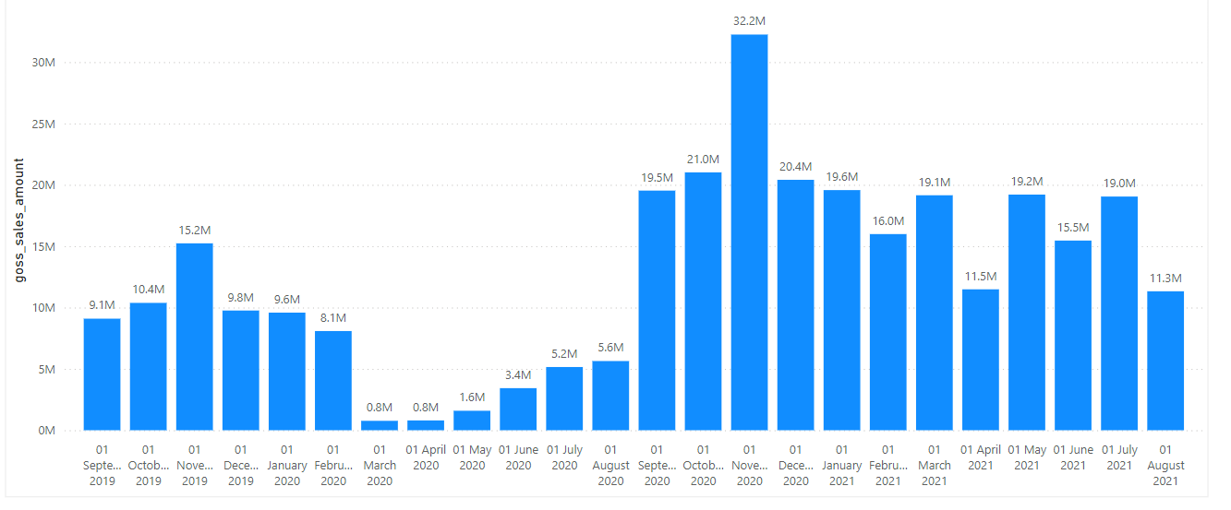

Slide 21
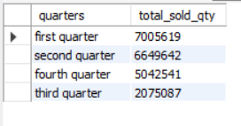
Request 8
In which quarter of 2020, got the maximum total_sold_quantity?

Slide 22
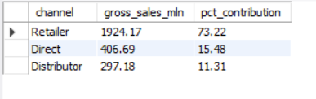
Request 9
Which channel helped to bring more gross sales in the fiscal year 2021 and the percentage of contribution?

Slide 23
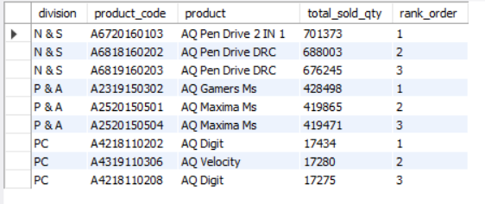
Request 10
Get the Top 3 products in each division that have a high total_sold_quantity in the fiscal_year 2021?

Slide 24
END
THANK YOU

